Slide 1








www.bt.com
#OurBTforYourBT’s
BUDTZ
TRIPS
Facing BT while planning a trip,
here We have a solution for you all......
Our Budtz Trip for your BTs
Get Started

Slide 2


CONTENT
01
GOALS AND OBJECTIVE
02
VALUES
03
STRATEGY
04
STATISTICS
05
TESTIMONIALS
06
OUR TEAM

Slide 3






GOALS AND OBJECTIVES
Objective n° 1
Objective n° 2
Objective n° 3
Gathering User Input for Vacation Planning
To begin planning a vacation, ask the user where they are from and where they would like to go. Additionally, ask for their total trip budget to ensure all planning is within their means.
Allocating the Budget: Travel, Accommodation, Food and Miscellaneous Items
To distribute your budget, split it into three parts according to this ratio: 20:40:30:10. This means that travel expenses should account for 20%, accommodation 40%, food 30%, and the remaining 10% can be used for purchasing miscellaneous items.
Present a Comprehensive Vacation Experience to the User within their Budget Range
To provide the best possible vacation experience for the user, it is essential to showcase the combined results of three options that fall within their budget range. This will ensure that the user has access to a complete and satisfactory travel package.

Slide 4

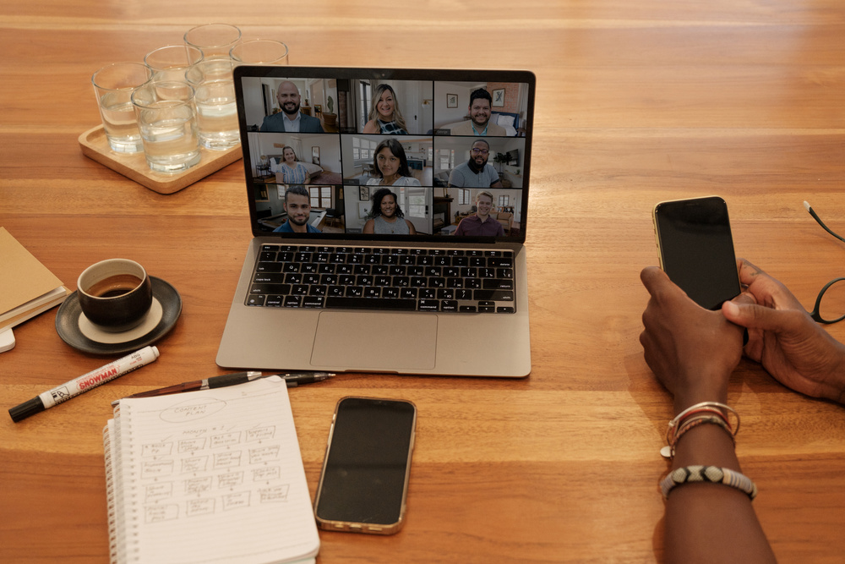

VALUES
Mission
Our mission is to assist individuals in using their expenses wisely by tracking their expenditures and utilizing them appropriately. Our goal is to enable them to live life to the fullest.
Vision
Our vision is to empower individuals to explore the world on a budget creating unforgettable travel experiences without compromising financial wellness.
We strive to be the go-to platform that simplifies travel planning, offering innovative tools and resources to optimise every aspects of budget friendly journeys.

Slide 5





STRATEGIES
Gathering Information for Travel and Dining Reservations
To plan your travel and dining arrangements, collect data from various websites that offer information on hotels, trains, buses, flights, and restaurants.
Compiling information from various resources according to the previously defined ratio rule (20:40:30:10).
Compiling Comprehensive Travel Packages
To provide users with a comprehensive list of their travel options (including accommodation and food), gather all the necessary information and display it in an elegant presentation.
STRATEGY N°1
STRATEGY N°2
STRATEGY N°3

Slide 6

STATISTICS
80%
The Importance of Proper Planning for Travel
Did you know that 80% of travelers don't plan their trips effectively? This often results in overspending and the need to borrow money, which can be detrimental to one's financial health.

Slide 7


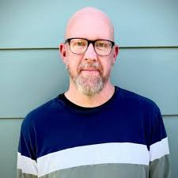
TESTIMONIALS
Suzy
Surprisingly , most of my travel budgeting mistakes were due to being regretfully tight on the purse strings but there’s still room to improve some overspending by making smarter choices.
krish Hughes
“Making a plan without the right tools is like making spaghetti without a pot.”

Slide 8

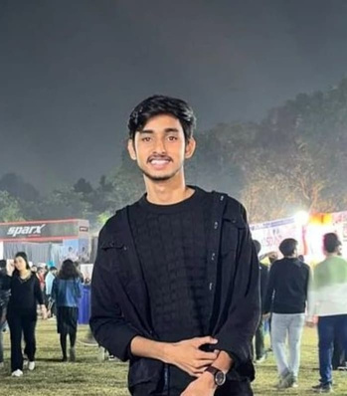
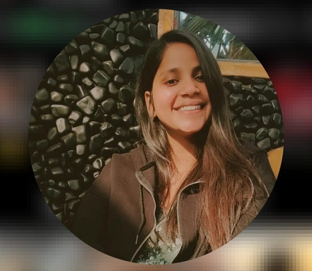
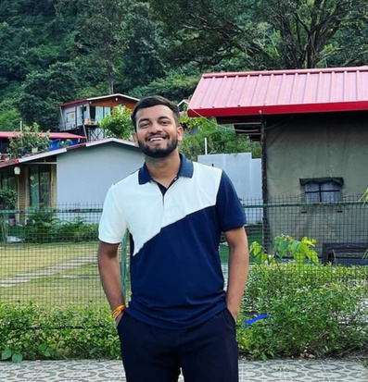
OUR TEAM
Vivek Attri
Rajveer
Choubisa
Kashish Agarwal
Siddharth Singh
CSE 2nd Year
ECE 2nd Year
CSE 2nd Year
CSE 2nd Year

